Slide 1
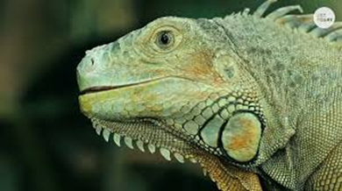
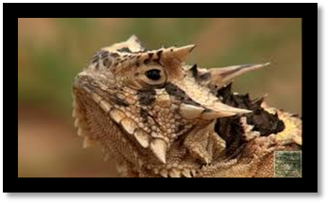
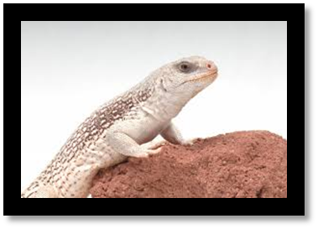
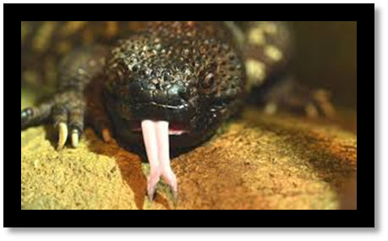
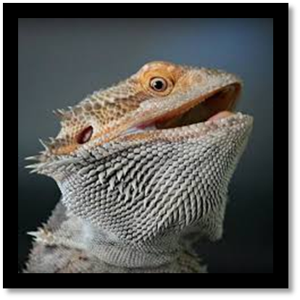
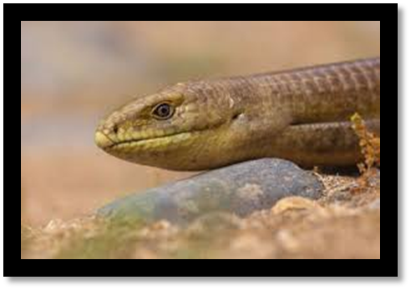
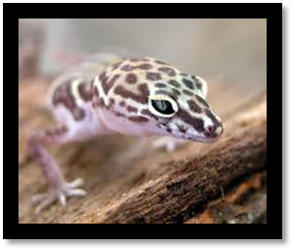
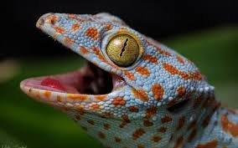
LIZARDS WE Learned about
Green Iguana
Horned Lizard
Desert Iguana
Beaded Lizard
Bearded
Dragon
Tokay Gecko
Banded Gecko
Legless Lizard

Slide 2
AWESOME ADAPTATIONS
Diet
Habitat
Activity
Defense
Common Features

Slide 3
What do they like to eat?
Carnivores
Beaded Lizard
Legless Lizard
Omnivores
Bearded
Dragon
Insectivores
Geckos
Horned lizards
Herbivores
Green Iguana
Desert Iguanas

Slide 4
AWESOME ADAPTATIONS
Diet
Habitat
Activity
Defense
Common Features

Slide 5
Where do they live?
Rain Forest
Green Iguana
Grass land
Legless Lizard
Tokay Gecko
Desert Iguanas
Beaded Lizard
Horned Lizards
Bearded Dragon
Banded Geckos

Slide 6
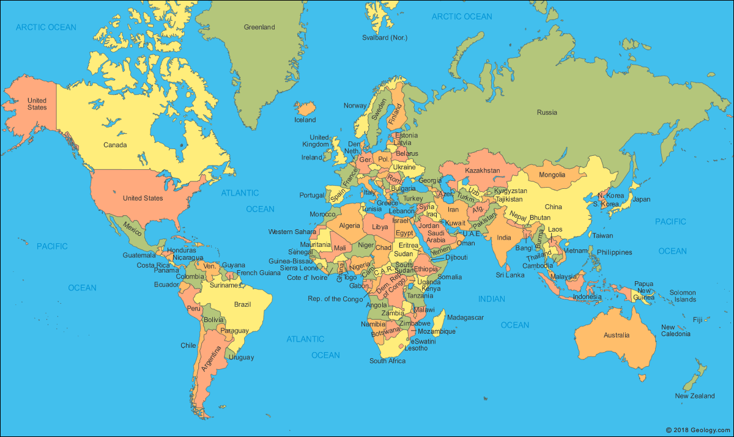
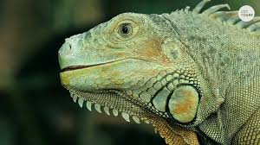
Rainforest

Slide 7
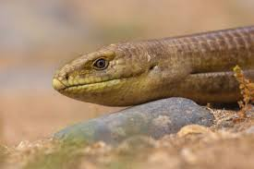
Forest/
Grassland

Slide 8
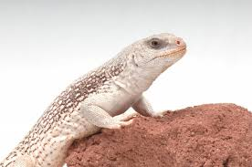
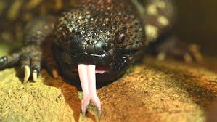
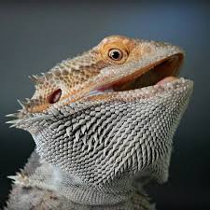
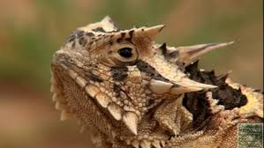
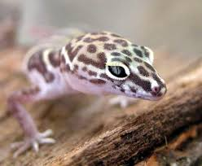
Deserts

Slide 9
AWESOME ADAPTATIONS
Diet
Habitat
Activity
Defense
Common Features

Slide 10
What schedule do they prefer?
DIURNAL
Active during the day
NOCTURNAL
Active at night
Green Iguana
Desert Iguana
Beaded Lizard
Horned Lizards
Bearded Dragon
Legless Lizard
Banded Geckos
Tokay Gecko

Slide 11
AWESOME ADAPTATIONS
Diet
Habitat
Activity
Defense
Common Features

Slide 12
What defenses do these lizards use?
Camouflage (all of these lizards)
Hiding and burrowing (geckos, legless lizard, horned lizards)
Fast sprinting (desert iguanas)
“Puffing up” and using spikes to look bigger and more threatening (bearded dragon, horned lizards)
Squirt out a stream of blood from behind the eyes at attacking animals. Both confuses predators and tastes awful if it gets into the predator's mouth (some horned lizards)
Venom glands in their lower jaws, and grooved teeth help to deliver the venom into prey (beaded lizards)

Slide 13
AWESOME ADAPTATIONS
Diet
Habitat
Activity
Defense
Common Features

Slide 14
What do they have in common?
Lizards
Scales
Eggs
Cold-blooded
Meta-chromatic

Slide 15
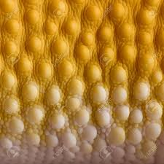
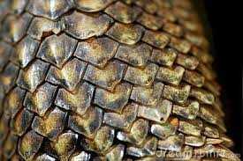
What do they have in common?
SCALES: They all have scales, even the “soft” geckos whose scales are small and smooth.

Slide 16
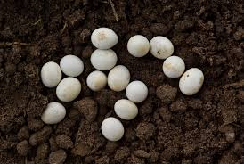
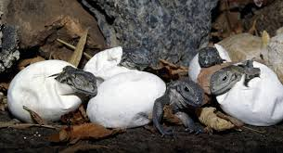
What do they have in common?
EGGS: Most lizards (and all of the ones we have here) lay eggs.

Slide 17
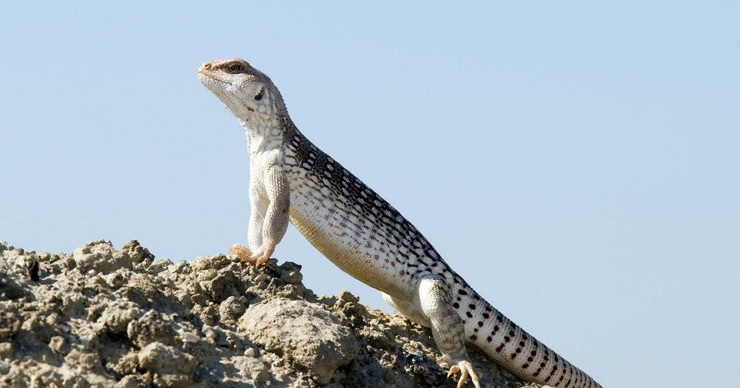
What do they have in common?
COLD-BLOODED: Also called ectothermic, their energy and metabolism depends on the temperature of their environment.

Slide 18
What do they have in common?
META-CHROMATIC: To help control their body temperature, they can change color. When temperatures cool, lizards turn darker to absorb heat. When temperatures rise, their color becomes lighter, which reflects sunlight and keeps the lizard cooler.

Slide 19
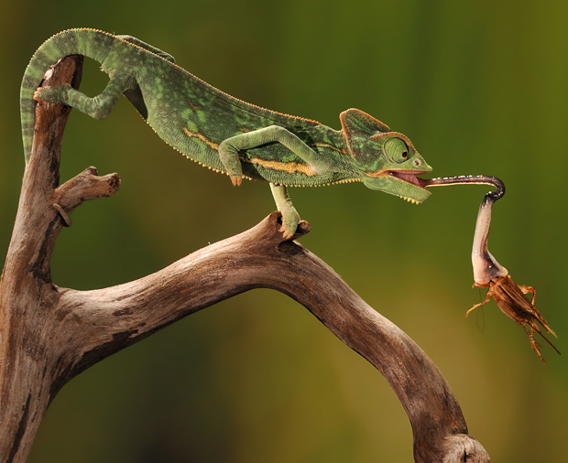
How do lizards help us?
They help control insect populations

Slide 20
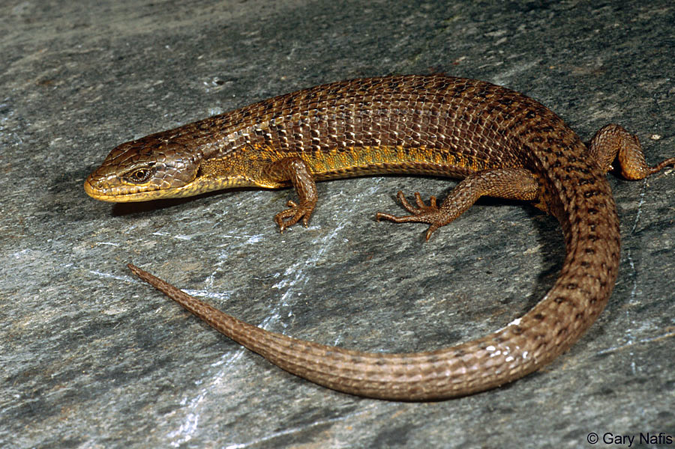
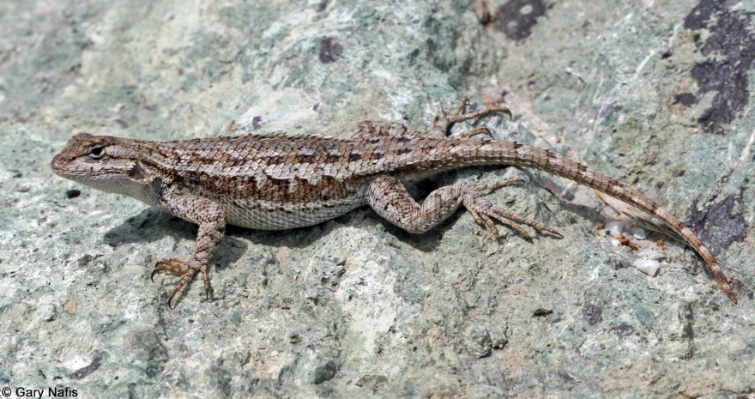
How do lizards help us?
Western fence lizards and alligator lizards remove Lyme disease from ticks.
That means if a tick bites one of these lizards, it won’t be a carrier of Lyme disease anymore!

Slide 21
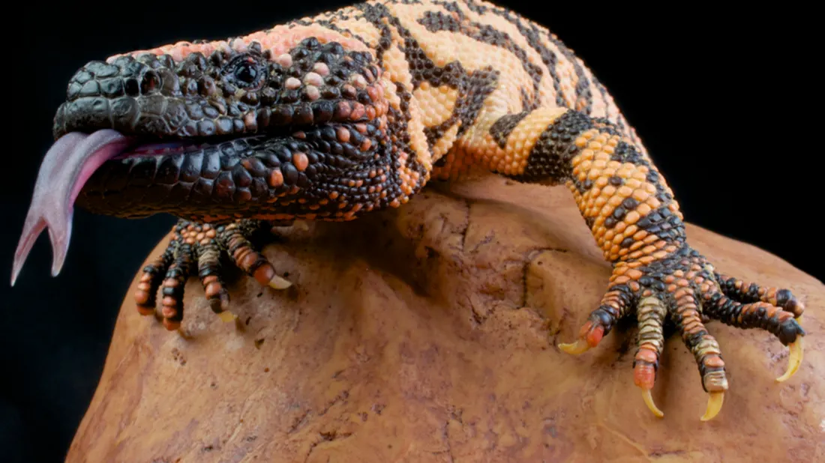
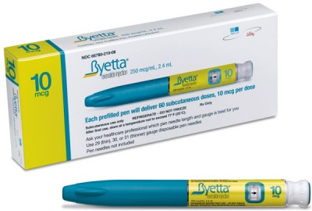
How do lizards help us?
Venom from Gila monsters has been used to make medicine for Diabetes!

Slide 22
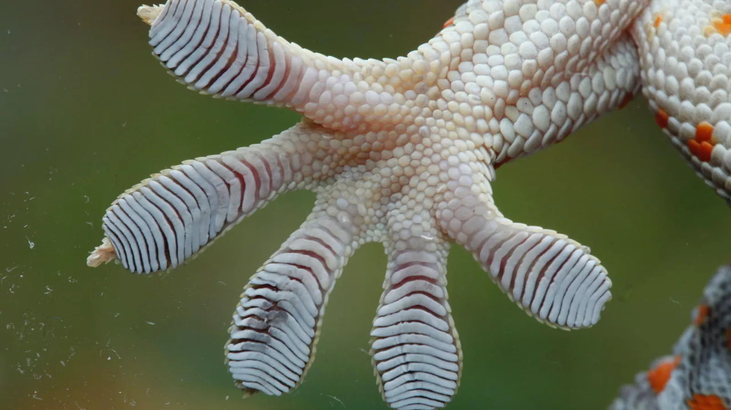
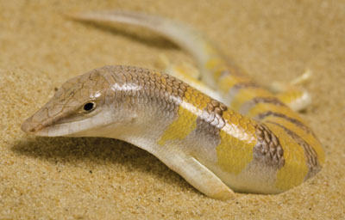
How do lizards help us?
Biomimicry
Sticky gecko feet
are helping engineers
design new adhesives!
Sandfish lizard scales
are being copied to
reduce friction in
machines!

